Slide 1
_ ×
Data Structures
Performance
Ja-Hee Kim@seoultech

Slide 2
Contents
01
02
Motivation
Measuring an Algorithm Efficiency
03
Asymptotic
Notation

Slide 3
Data Structures . Performance
Motivation

Slide 4
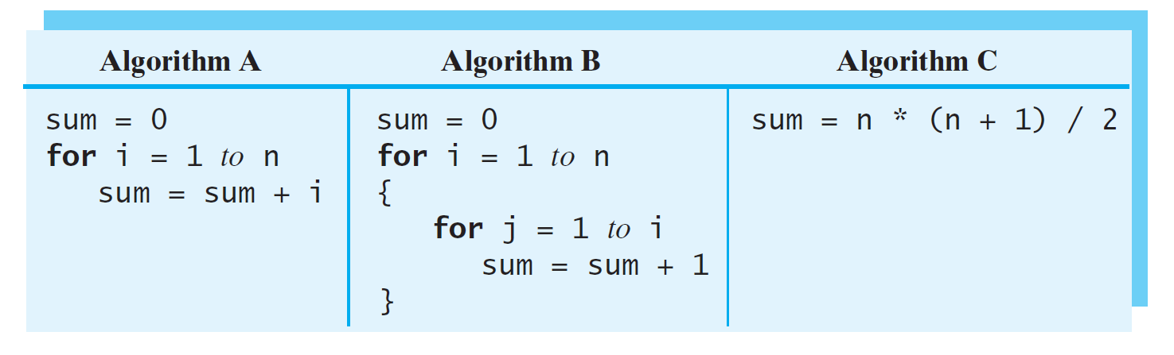
Example
𝑛
𝑠𝑢𝑚 = ෍ 𝑖
𝑖=1

Slide 5
Most Efficient
Lower complexity is better
Usually the “best” solution to a problem balances various criteria such as time, space, generality, programming effort, and so on.
Time complexity:
Time requirement
the time it takes to execute
Space complexity:
Space requirements
the memory it needs to execute

Slide 6
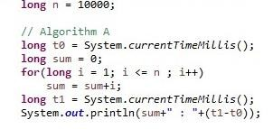

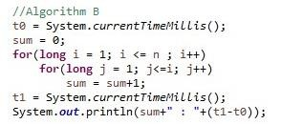

Sum from 1 to n
How much time to add 1 … n
Algorithm A
Algorithm C
Result
Algorithm B

Slide 7
Factors
Factors that determine running time of a program
problem size
basic algorithm / actual processing
memory access speed
CPU/processor speed
the of processors?
compiler/linker optimization?

Slide 8
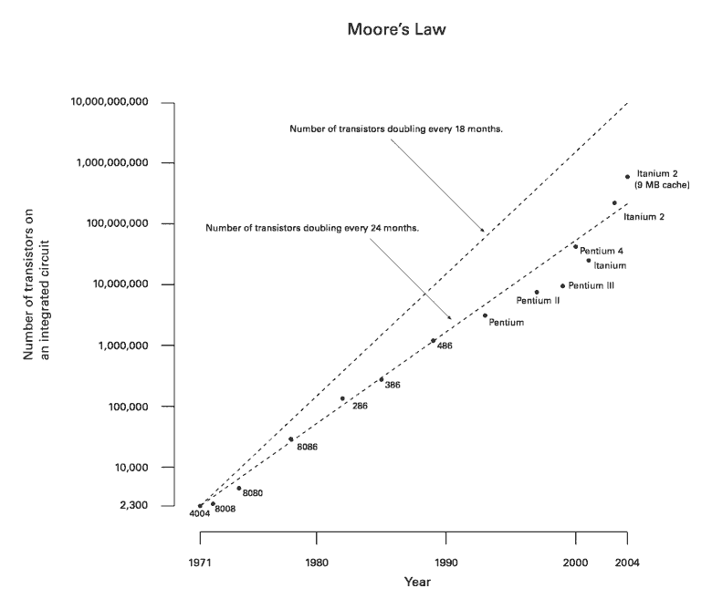
Moore’s law

Slide 9
Data Structures . Performance
Measuring an Algorithm Efficiency

Slide 10
Terminology
Analysis of algorithms
the process of measuring the complexity of algorithms
Problem size
the number of items that an algorithm processes
Basic operation
the most significant contributor to its total time requirement
the most frequent operation is not necessarily the basic operation such as assignments, control loop
Simplified analysis can be based on : number of arithmetic operations performed, Number of comparisons made, Number of times through a critical loop, Number of array elements accessed, etc
directly proportional
the time requirement increases by some factor
growth-rate function: T(n)
how an algorithm’s
The number of basic operations for n

Slide 11
Constant time
T(n)=3

Slide 12
Linear time
The number of basic operations
n | 0 | 1 | 2 | 3 | 4 | 5
T(n)
T(n) = n

Slide 13
Quadratic time
The number of basic operations
n | 0 | 1 | 2 | 3 | 4 | 5
i
j
T(n)
_{= σ}𝑛
2
_{𝑖 =} 𝑛(𝑛+1) ₌ 𝑛 ₊ 𝑛
2 2 2
𝑇 𝑛
𝑖=1

Slide 14
Necessary time
B
The number of basic operations
A
14
12
10
8
6
4
2
0
 | A | B | C
Additions | n | n(n+1)/2 | 1
Multiplications |  |  | 1
Divisions |  |  | 1
Total | n | 𝑛² 𝑛 2 ⁺ 2 | 3
C
0 2 4 6 8 10 12 14

Slide 15


Growth-rate function
Dominant term: the term the one dominating as n gets bigger
Polynomial-time algorithm
f(n)
n=10³
n=10⁵
n=10⁶
log₂(n) 10⁻⁵ sec 1.7 * 10⁻⁵ sec 2 * 10⁻⁵ sec Lo
garithmic algorithm
near algorithm
n*log₂(n) 0.01 sec 1.7 sec 20 sec
adratic algorithm
n³ 17 min 32 yr 317 centuries
fast
n 10⁻³ sec 0.1 sec 1 sec Li
n² 1 sec 3 hr 12 days Qu
2^{n} 10²⁸⁵ centuries 10¹⁰⁰⁰⁰ years 10¹⁰⁰⁰⁰⁰ years Ex
ponential algorithm
slow

Slide 16
Data Structures . Performance
Asymptotic Notation

Slide 17
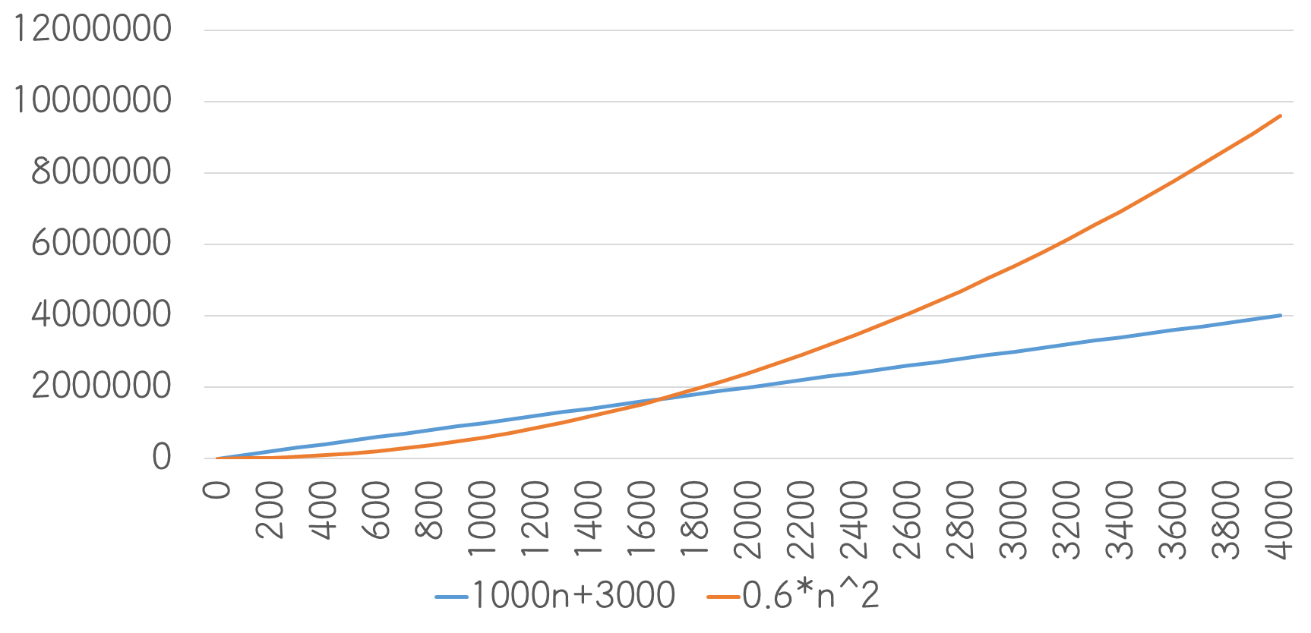
Asymptotic

Slide 18
Asymptotic notations
O
Big O notation
Asymptotic upper bound
Ω
Big Omega
Asymptotic lower bound
Θ
Big Theta notation
Asymptotic upper and the lower bound

Slide 19
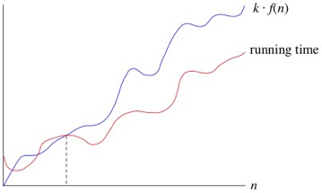
O-notation
Upper bound of the running time of an algorithm
𝑓(𝑛) ∈ 𝑂(𝑛²)
n²
3n²+2n
3n²+n log n
n log n
3n

Slide 20
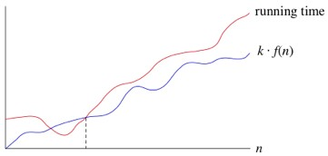
Ω-notation
Upper bound of the running time of an algorithm
𝑓 𝑛 ∈ Ω(𝑛²)
n²
3n²+2n
3n²+n log n
7n³+5n

Slide 21
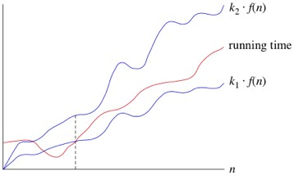
Θ-notation
Tight bound of the running time of an algorithm
Θ 𝑛² = 𝑂(𝑛²) ∩ Ω(𝑛²)

Slide 22
∈→=
Proper notation
𝑇(𝑛) ∈ 𝑂(𝑛²)
General notation
𝑇 𝑛 = 𝑂(𝑛²)
Wrong notation
𝑂 𝑛² = 𝑇 𝑛

Slide 23
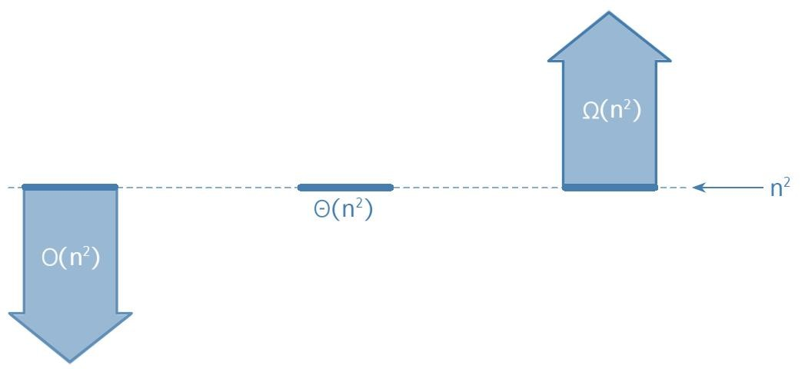
Relation of notations

Slide 24
Thank you!
-
X
Questions?
Exit

